Slide 1
CS1675 Recitation #5: 9/28/18
These slides are available online:
https://github.com/kc13/CS1675
Agenda for today:
Discussion of overfitting/regularization
K Nearest Neighbor Classification

Slide 2
Regularization review (using images from lecture slides):
When fitting functions to data, we are often confronted with a bias-variance tradeoff.
Models with very few free parameters are considered high bias.
A linear regression model (i.e., 1st order polynomial) might be considered a high bias model. It lacks the flexibility to capture the trends in data that follow a curvier function.

Slide 3
Regularization review (using images from lecture slides):
Models with very many free parameters are considered high variance.
In the context depicted on the right, a 9th order polynomial might be considered a high variance model.
It can account for more complex trends, but is also overly sensitive to noise that may be specific to the training data.
Although the fit to the training data is very good, generalization to predicting test values may be relatively poor.
This is the problem of overfitting.

Slide 4
Regularization review (using images from lecture slides):
Regularization proposes that we address this overfitting problem by using a loss function that discourages large weight values.
In a sense, we want to discourage sharp stretching of the fitted polynomial.

Slide 5
Regularization review (using images from lecture slides):
With regularization, the loss function adopts a new term (adapted from 3.27 in Bishop):
$L\left(w\right)= \frac{1}{2}\sum_{n=1}^{N}{{\{y−y′\}}^{2}+ \frac{λ}{2}w^{T}w}$
where higher lambda → more regularization (a larger contribution of the weight vector the loss estimate).

Slide 6
Regularization review (using images from lecture slides):
If we were applying regularization to simple linear regression (hypothetically; not necessarily useful in practice for a high bias model), how does the loss gradient change?
For standard regression:
For regularized regression:
Practical implication: For gradient descent, the weight update is subtracted by an extra amount = to λw.
+ λw

Slide 7
Downloads:
For KNN (make sure all in the same working directory):
https://github.com/kc13/CS1675/rec5_KNN.m
https://github.com/kc13/CS1675/rec5_knn_data.mat

Slide 8
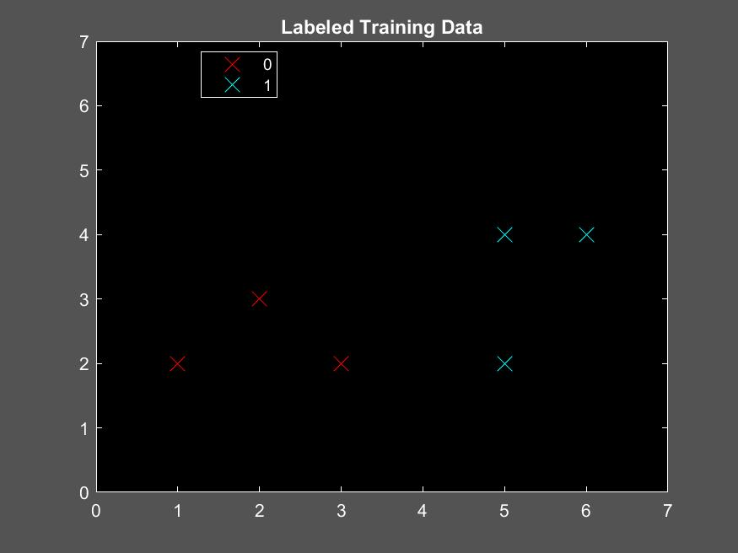
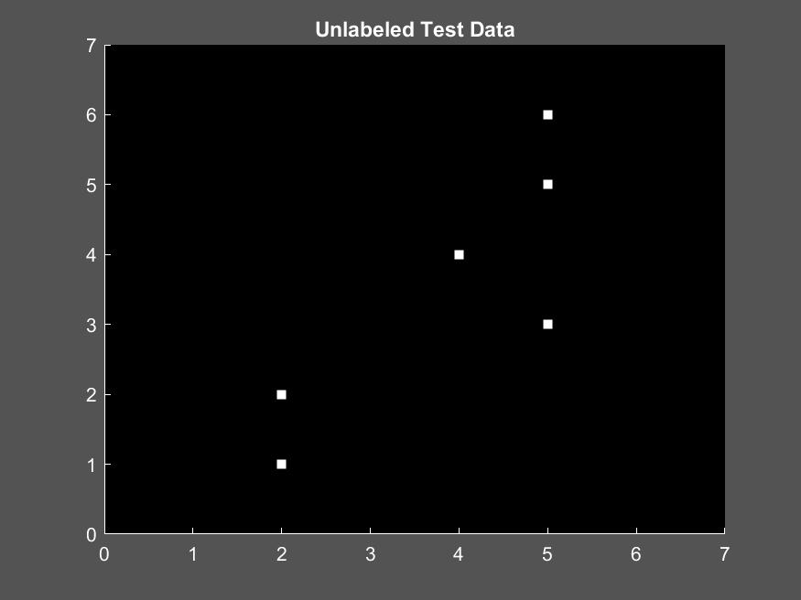
KNN tasks:
As described in the .m file:
Run the first few sections to load and plot the training and test data.
Estimate the labels for the test data by hand (or by eye) for a K-Nearest Neighbors classifier, assuming a Euclidean distance metric and K = 3.
See slides 9-14 from the classification slides for a reminder of how KNN works.

Slide 9
KNN tasks:
One you have found the predicted labels:
In the designated place in the script, create a yPred vector of labels that correspond to the data in xTrain.
Then run the next section of the script. This will create plots that will help visualize the KNN predictions.
Compare yPred to yTest. How well did KNN perform?
The answer to this is already available in the slides.
Does performance change with different values of K?
The answer to this will be posted after recitation.

Slide 10
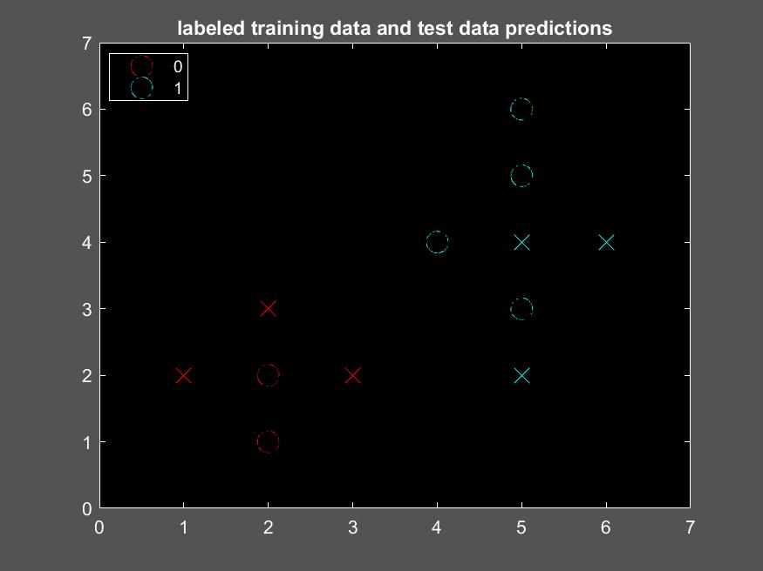
KNN solution (for K = 3):
The classification was 100% accurate (yPred matches yTest exactly).

Slide 11
KNN solution (also for K = 1,2,4,5):
The classification was 100% accurate (yPred matches yTest exactly).

Slide 12
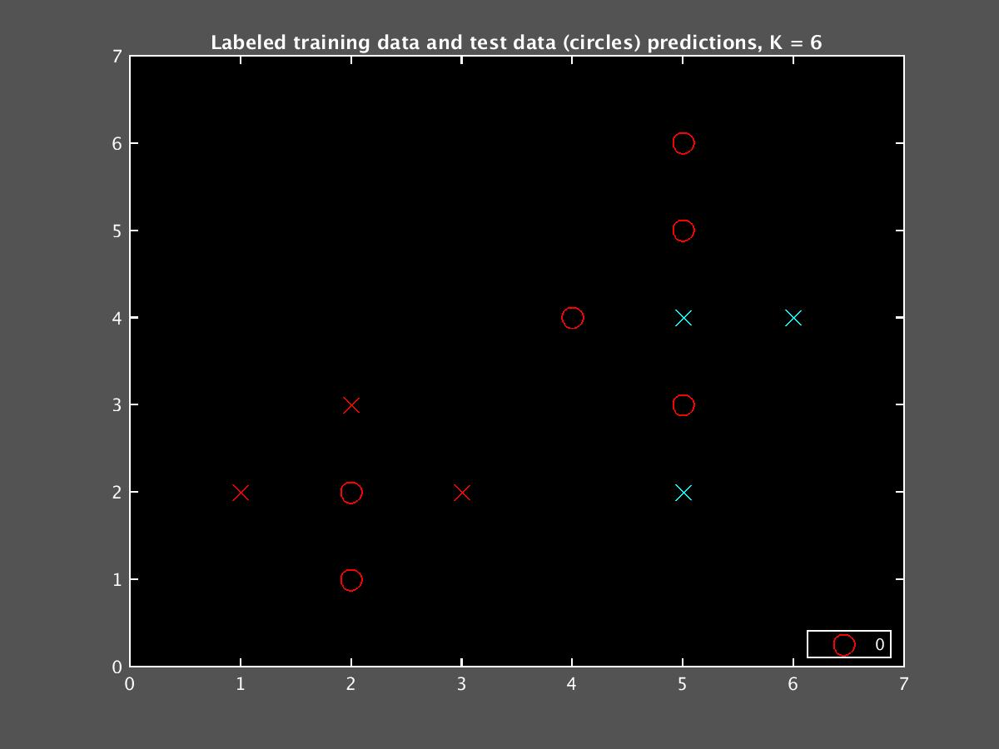
Possible KNN solution (for K = 6):
The results with this K depend on how a tie between 3 and 3 is broken. (Multiple tie breaking rules exist, see https://www.mathworks.com/help/stats/classificationknn.html for some examples).

